Slide 1
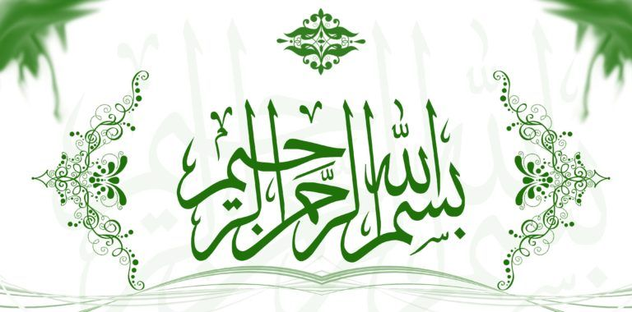

Slide 2
PRESENTATION

Slide 3
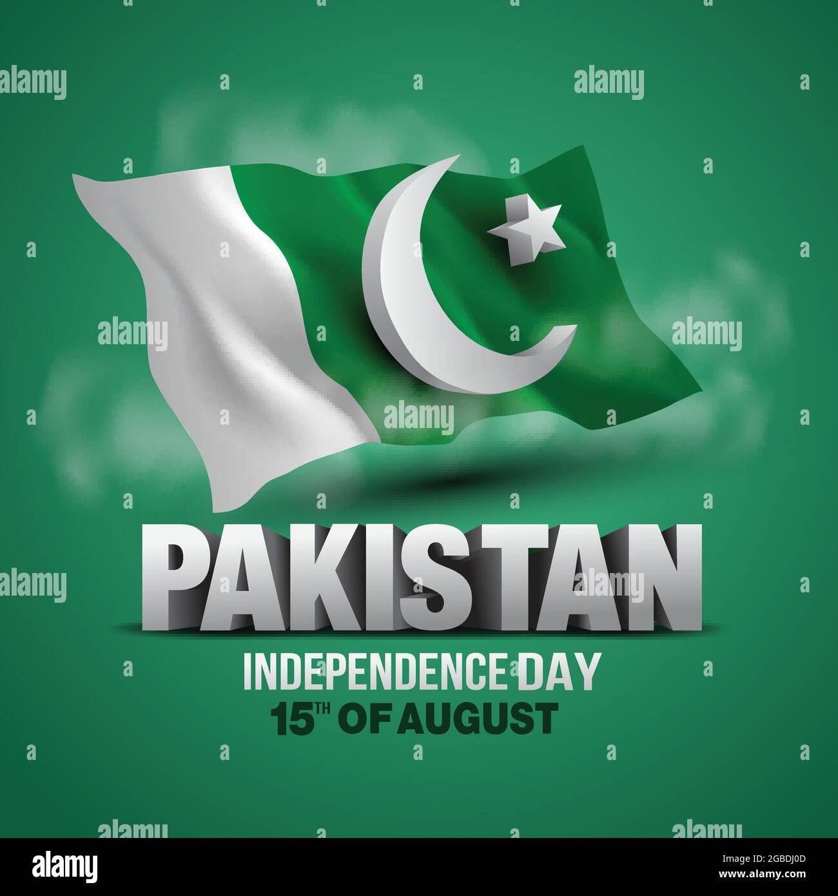

Slide 4
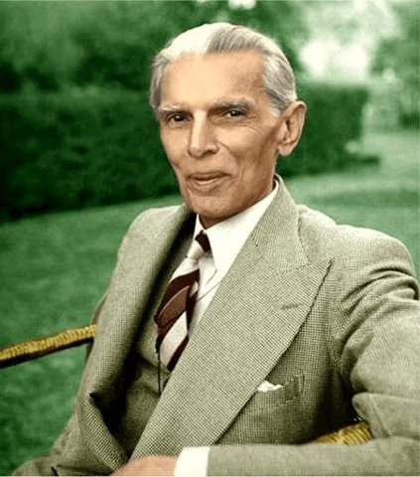
ROLE OF QUID E AZAM
Quaid-e-Azam Muhammad Ali Jinnah played a pivotal role in the independence of Pakistan. As the prominent leader of the All-India Muslim League, he championed the Two-Nation Theory, advocating for a separate Muslim state. On August 14, 1947, Pakistan gained independence from British rule, and Jinnah became its first Governor-General. In his historic address to the Constituent Assembly, he laid the foundation of the new nation and highlighted the challenges ahead. His visionary leadership and unwavering determination were instrumental in the creation of Pakistan, and he is revered on Independence Day as the founding father of the country.

Slide 5
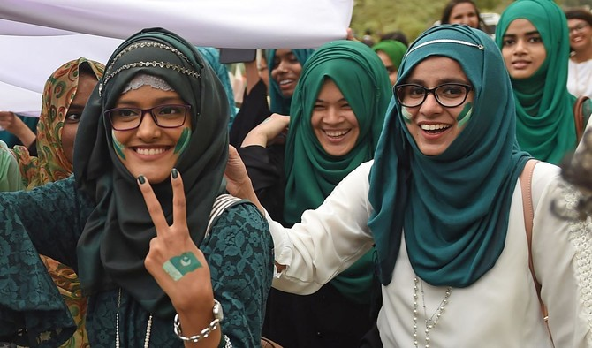
IMPORTANCE OF INDEPENDENCE DAY
Independence Day holds great importance for the people of Pakistan as it marks the nation's liberation from British colonial rule on August 14, 1947. This day is a symbol of national pride and unity, reminding Pakistanis of the sacrifices made by their forefathers in securing a separate homeland. It instills a sense of patriotism and collective identity, transcending cultural and regional differences. Independence Day serves as a moment to reflect on the nation's progress, democratic values, and the challenges ahead. The celebrations on this day foster a spirit of hope, renewal, and appreciation for the freedom and opportunities enjoyed in an independent nation.

Slide 6
INDEPENDENCE DAY CELEBRATION IN PAKISTAN
FALAG HOISTING
FIREWORKS
CULTURAL SHOWS
DECORATIONS
DRESSING IN GREEN AND WHITE
DECORATING VIHICLES
NATIONAL SONGS AND ANTHEM
SPECIAL PRAYERS

Slide 7
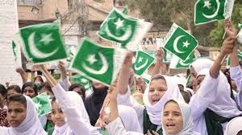
FLAG HOISTING
People across Pakistan celebrate independence day by hoisting the national flag at home, public places and government buildings reflecting their patriotism and love for the country.

Slide 8
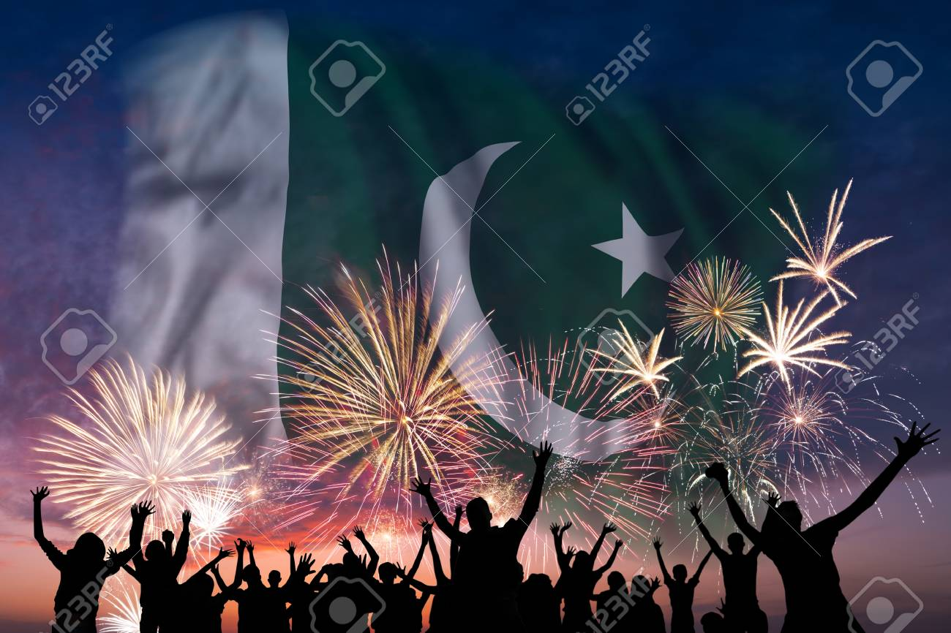
FIREWORKS
Spectacular fireworks displays light up the night sky, adding a festive touch to the celebration.

Slide 9
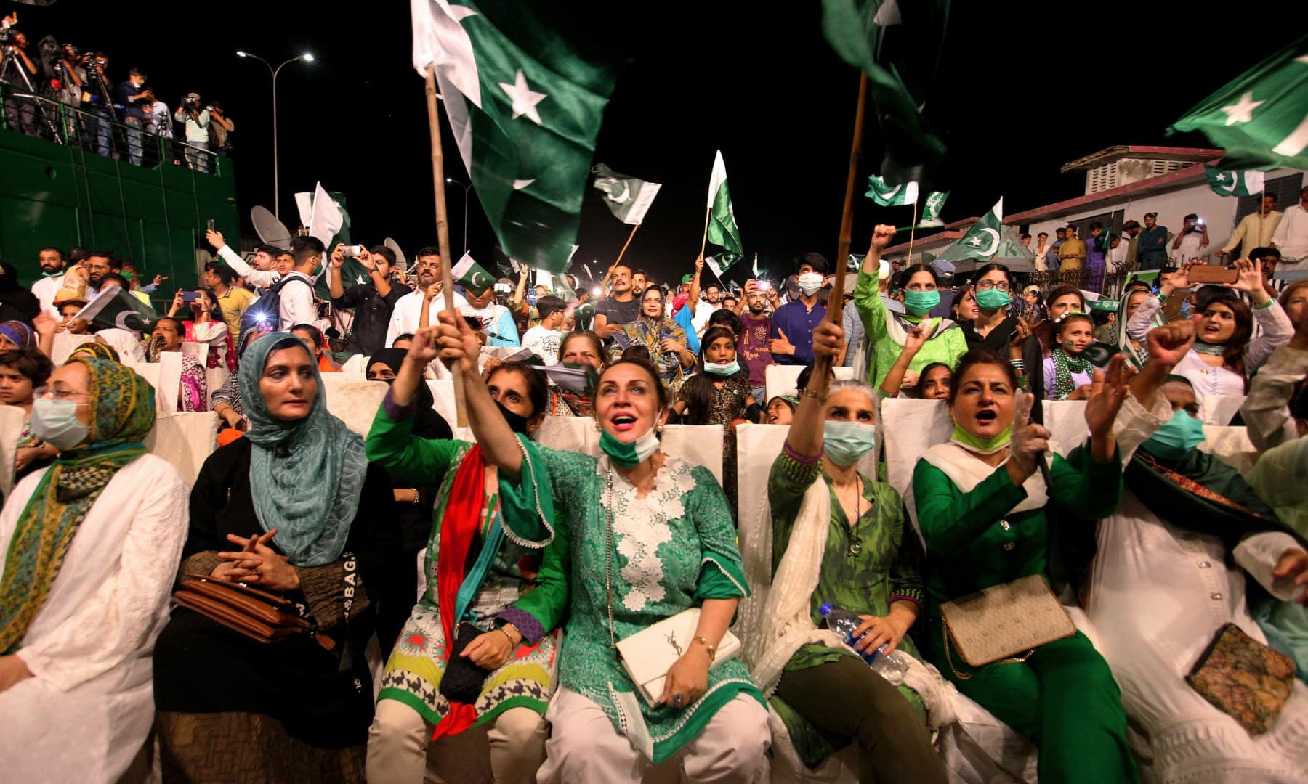
CULTURAL SHOWS
Traditional dances, music performance and cultural exhibition showcase the rich diversity of Pakistan heritage.

Slide 10

DECORATIONS
Streets, buildings, and public space are adorned with green and white decorations, Pakistan national colors.

Slide 11
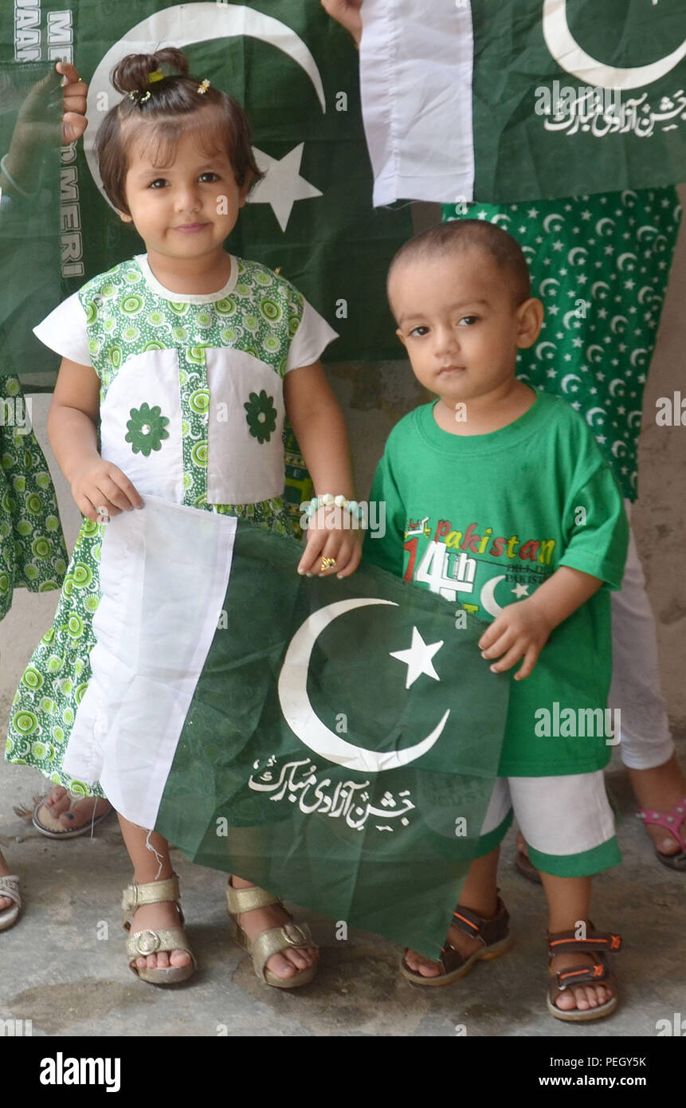
DRESSING IN GREEN AND WHITE
People dress in green and white attire and accessorisze with badges, pins, representing the Pakistan flag.

Slide 12
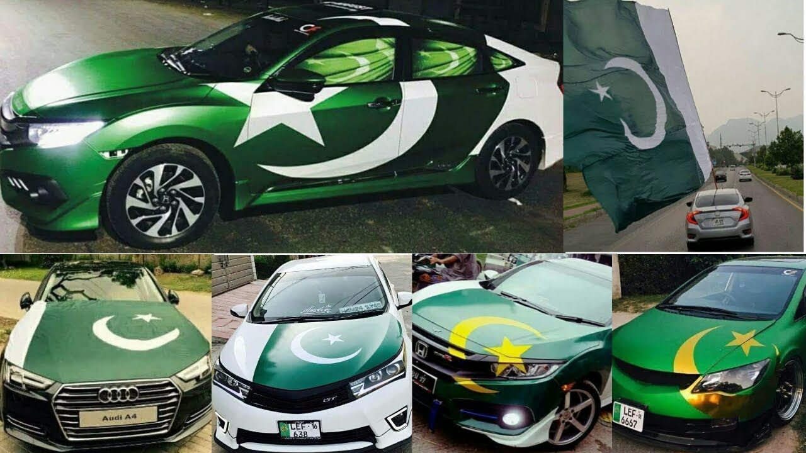
DECORATING VIHICLES
On independence day Pakistani people decorate vihicles with flag, stickers and patriotic slogams showcasing their love and pride for the nation,colorfull adorments create a festive atmosphere spreading national spirit across the road.

Slide 13
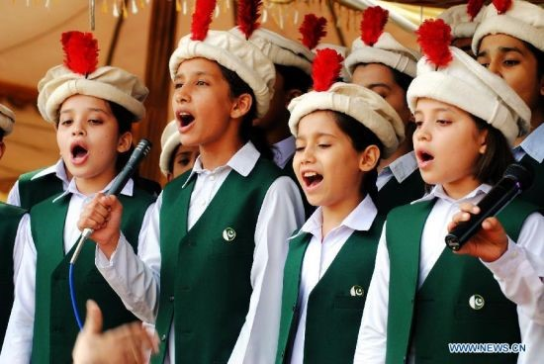
NATIONAL SONGS AND ANTHEM
On independence day , Pakistani people passionality sings national songs and anthem to express their love for the country.

Slide 14
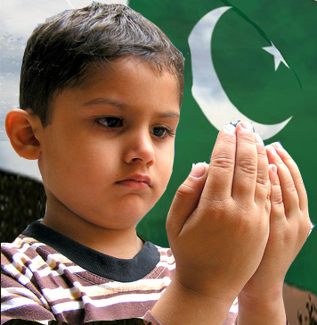
SPECIAL PRAYERS
Religious ceremonies and prayers are held in mosque and other places of worship to seek blessing for the nation and its prosperity.

Slide 15
INTRESTING FACTS ABOUT PAKISTAN
WORLD’S SECOND LARGEST SALT MINE
WORLD’S LARGEST FOREST
WORLD’’LARGEST DEEP SEA PORT
WORLD’S LARGEST MOSQUE
WORLD’S LARGEST MOUNTAIN

Slide 16
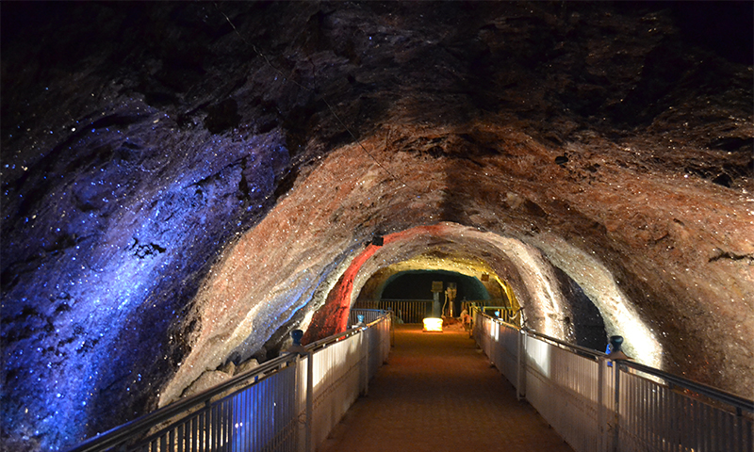
WORLD,S SECOND LARGEST SALT MINE
The ‘Khewra Salt Mine’ in Pakistan is the second largest and oldest salt mine in the world

Slide 17
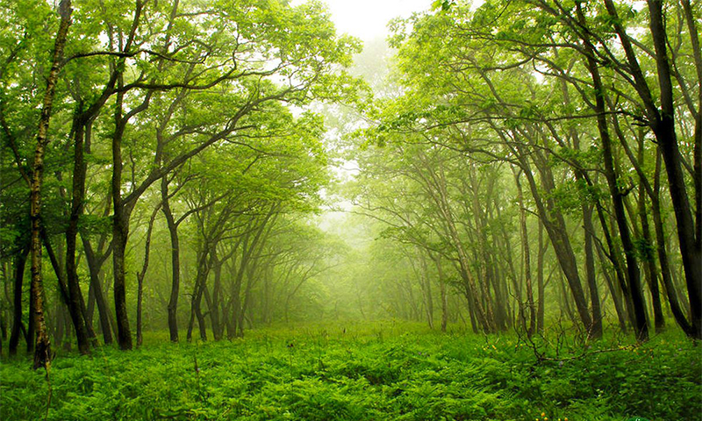
World largest forest
The once world’s largest man-made forest is in Pakistan – the Changa Manga forest (12,423 acres in area). It is named after two brother dacoits, the Changa Manga forest was originally planted in 1866 by British foresters.

Slide 18
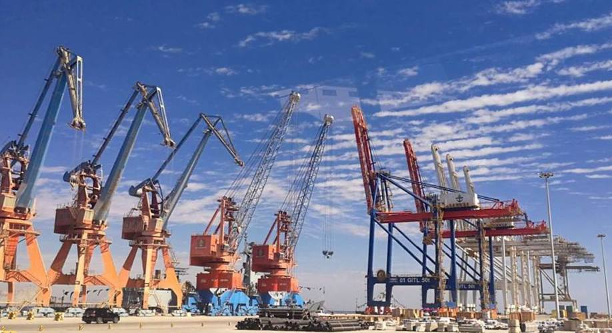
World largest deep sea port
Gwadar port is the largest deep sea port in the world, located on the southwestern Arabian Sea along the coastline of Balochistan, Pakistan. The port has an area of 64,000 square meters and has a depth of more than 14 meters.

Slide 19
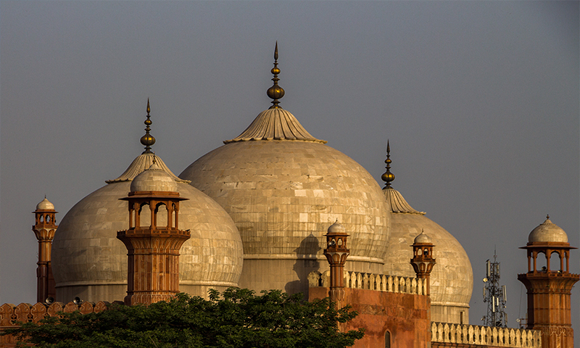
WORLD LARGEST MOSQUE
The Badshahi Mosque in Lahore, Pakistan is one of the world’s largest mosques. It was commissioned by the Mughal emperor Aurangzeb in 1671 and its construction completed in 1673. However, the mosque was largely used for military purposes during the Sikh era and the British rule for many years until the independence of Pakistan when it was restored to its original condition

Slide 20
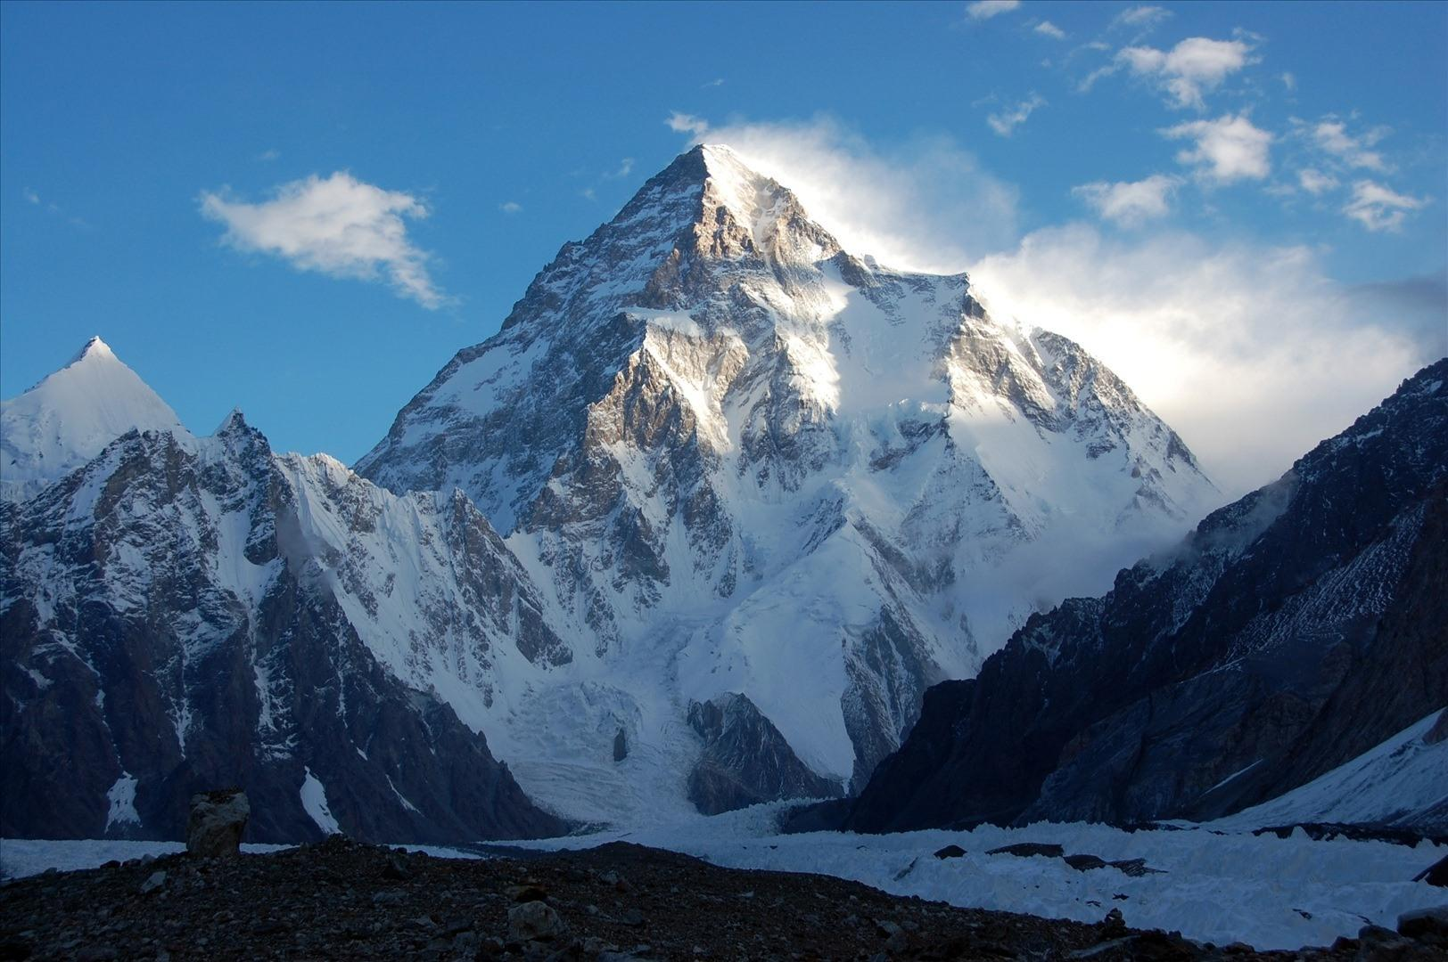
WORLD LARGEST MOUNTAIN
K2 is the highest point of the Karakoram Range and the highest point in Pakistan. K2 is known as the Savage Mountain due to the difficulty of ascent and the second-highest fatality rate among the eight thousanders. For every four people who have reached the summit, one has died trying.

Slide 21
LANGUAGES IN PAKISTAN

Slide 22


Slide 23
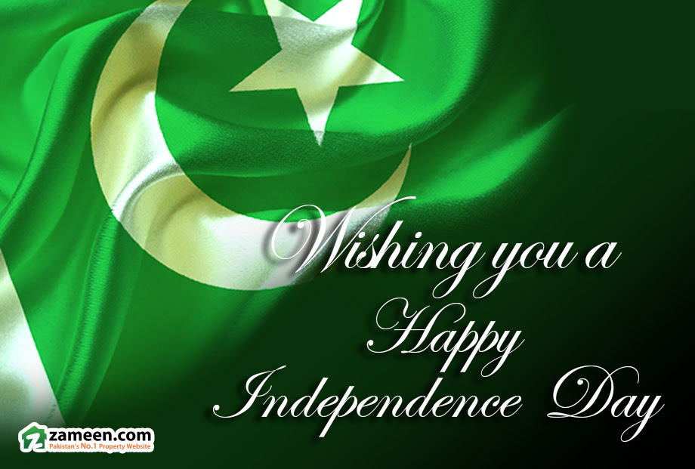

Slide 24


